Slide 1

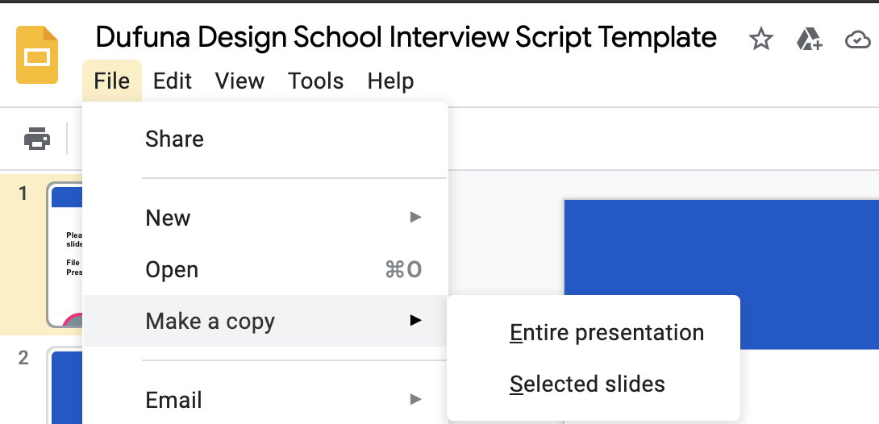
Please make a copy of these slides
File → Make a copy → Entire Presentation
Dufuna CodeCamp

Slide 2

Dufuna CodeCamp

Slide 3
Interview Script
By: Ochuba Chukwuemeka
Dufuna CodeCamp

Slide 4
1 of 6
Questions about the Interview subject (add questions about the subject here, we have provided one question for you but bear in mind that you want to know as much as needed about your subject)
Question 1: Tell me about yourself
Question 2: How did you hear about this app?
Question 3: What attracted you to this app?
Question 4 : If you have ordered online before, how quickly did your food arrive?
Question 5 : Have you used any discount or special offers while ordering online?
Question 6 : Is there anything that you want on previously used food ordering app that is missing?
Dufuna CodeCamp

Slide 5
2 of 6
Questions about what food means to them (remember to ask questions that will help the interview subject discuss the meals they love, why they love the meals and any interesting stories about food)
Question 1: What does food mean to you?
Question 2 : What is your favorite dish?
Question 3 : Do you enjoy eating spicy food? How hot do you like it?
Question 4 : Would you send the food back if it did not taste good or if you were served the wrong food?
Question 5 :Have you ever had a bad experience in a restaurant? What happened
Question 6 :What is the most disgusting food that you ever ate in a restaurant?
Dufuna CodeCamp

Slide 6
3 of 6
Questions about eating out (remember to ask questions that will help the interview subject discuss eating out, when they eat out, why they eat out and any interesting stories about food)
Question 1 : How often do you eat out?
Question 2 : Who do you usually go with when you eat out?
Question 3 : If you have a dietary restriction, were you accommodated?
Question 4 : Do you worry about calories and fat content when you eat out?
Question 5 : Were you pleased with their drink offering?
Question 6 : How would you rate the value of their food?
Dufuna CodeCamp

Slide 7
4 of 6
Questions about ordering food (remember to ask questions that will help the interview subject discuss ordering food, when they order food, why they order food and any interesting stories about food)
Question 1: How often did you order food?
Question 2 : What is your experience while ordering food?
Question 3 : If you have ordered online before, how quickly did your food arrive?
Question 4:Did you enjoy using our check-out system?
Question 5: Will you recommend this app to your friends?
Question 6 : Have you used any discount or special offers while ordering online?
Dufuna CodeCamp

Slide 8
5 of 6
Any other questions (Bonus marks for adding your own question categories)
Question 1 : Can you tell us about your previous fast food experience?
Question 2 : Do you ever drink alcoholic beverages when you eat out?
Question 3 : Have you ever worked in a restaurant?
Question 4 : What is the best drink to have with a meal?
Question 5 : Do expensive restaurant always serve better food?
Question 6 : Do you ever read a restaurant review? Are they useful?
Dufuna CodeCamp

Slide 9
6 of 6
Any other questions (Bonus marks for adding your own question categories)
Question 1 : Do you prefer to eat in the same restaurant or explore new ones?
Question 2 : What is the best thing about eating out?
Question 3 :What is your favorite appetizer?
Question 4 : What is the best restaurant in your city?
Question 5 : How have your eating habits changed over the years?
Question 6 : Can you describe a customer service that annoys you?
Dufuna CodeCamp

